Slide 1
Welcome

Slide 2
Introduction
Muhammad TajKir Hossain Senior Teacher Moniria High School Parbatipur, Dinajpur
Subject: English
Class: Eight
Unite: Nine
Lesson: 1
Title: The Wheel

Slide 3
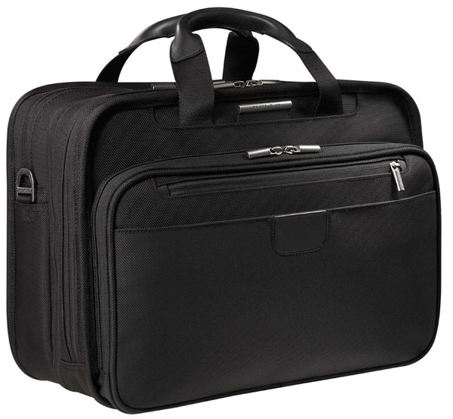
Which one is easier to move? Why?

Slide 4
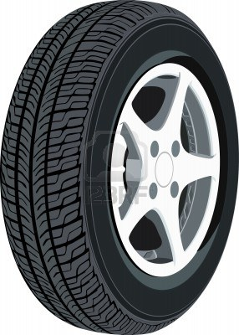
The Wheel

Slide 5
Learning outcomes:
By the end of the lesson, learners will be able to-
use key words:- Invent, Civilization, Turbine
read and answer questions
participate in conversations
fill in the blanks

Slide 6
Turbine
A type of machine which is used to generate power
The turbine is used to move wheel

Slide 7
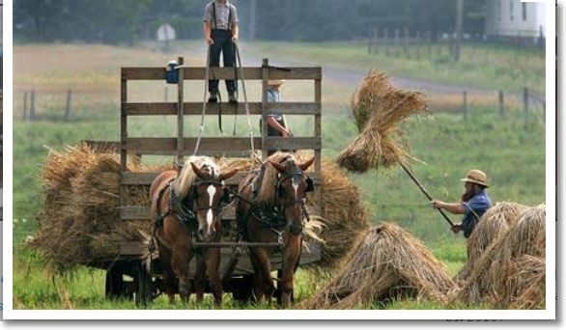
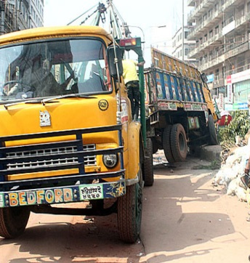
Civilization
The stage of human social development
The civilization is changed day by day.

Slide 8
Invent
Create something that has not existed before
Bill Gates has invented Microsoft word.
Notes:
At

Slide 9
Read the text silently and answer the following questions
Ask & answer the questions in pairs
a. What is a wheel?
Answer: A wheel is a circular object
b. Where can we find wheels?
We can find wheels everywhere on automobiles, on most factory and farm equipment.

Slide 10
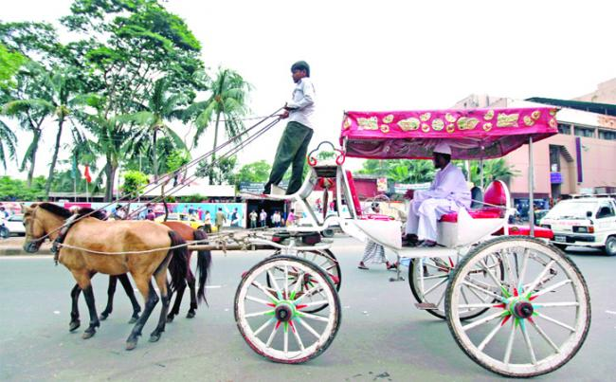
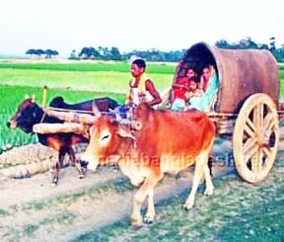
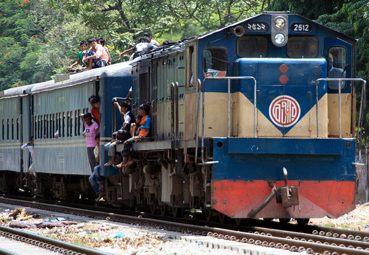
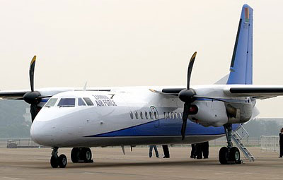
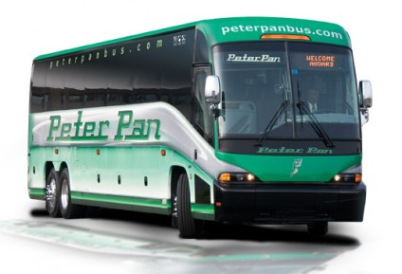
Some uses of wheels

Slide 11
a) What are the uses of wheel? b) How have wheels helped human civilization?
Group Work

Slide 12
Fill in the blanks with suitable word from the box:-
difficult
much
Circular
important
heavy
first
Although the wheel is a very (a) …… invention, the history of its origin is unknown. Experts guess that the first wheel was developed from a circular object. The early man observed that a huge piece of stone could be rolled easily if it was (b) ………. in shape. Similarly, a heavy tree-trunk is (c) …… to carry ; but it can be rolled away with less effort. Even , a gigantic tree-trunk can be moved easily using other small and round trunks as rollers under it. Thus, early man took advantage of rolling objects and developed the
(d) ….. wheel. Apart from its mechanical advantage, a wheel’s mobility has contributed (e) …… to the civilization.

Slide 13
Home Work
Have you ever travelled by bus or car? Do you have any experience of one wheel falls flat while travelling? If yes, give a description of your experience. If no, imagine such a situation and write a paragraph about it.

Slide 14
Thanks

